Slide 1
Cyber Threat Assessment Program
(CTAP)

Slide 2
Agenda
What is CTAP
Benefits
How It Works
Report Content
Why Us?
Q&A

Slide 3




Cyber Threat Assessment Program
Report on status of your security, productivity, and utilization
No cost or risk to you or your customers
Requires
less than
30 minutes of customer time
Done in a week or less

Slide 4


Benefits
Get an in-depth view of the current state of your network
See if your current security infrastructure can accurately detect today’s sophisticated attacks
See how apps (traditional and web-based) are truly being utilized on your network
See if your current security solution will be able to meet increased throughput and encryption demands

Slide 5




How it works
Install CTAP device at your site
Monitor traffic logs for 3 to 7 business days
Generate report
Discuss findings and retrieve CTAP device

Slide 6







Why our CTAP?
Superior visibility*
Additional insights & opportunity
Deployment flexibility
Actionable
recommendations
Insights from
experts
Personal &
courteous approach
* powered by content security and threat intelligence from FortiGuard Labs

Slide 7
Security
Can your security posture be improved?
Application vulnerabilities
Malware/botnet detection
Identify risky applications

Slide 8
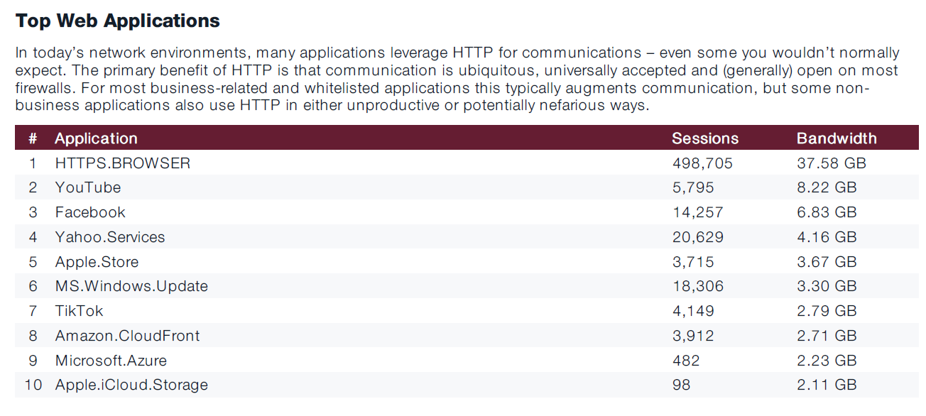
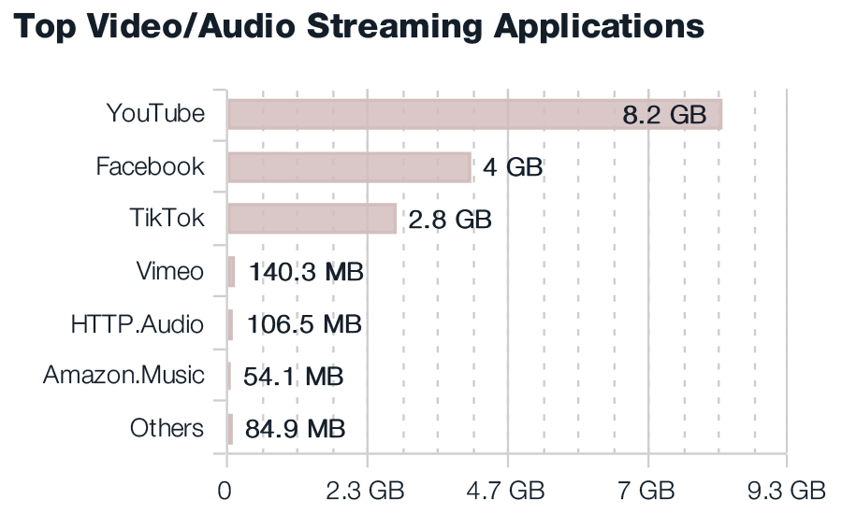
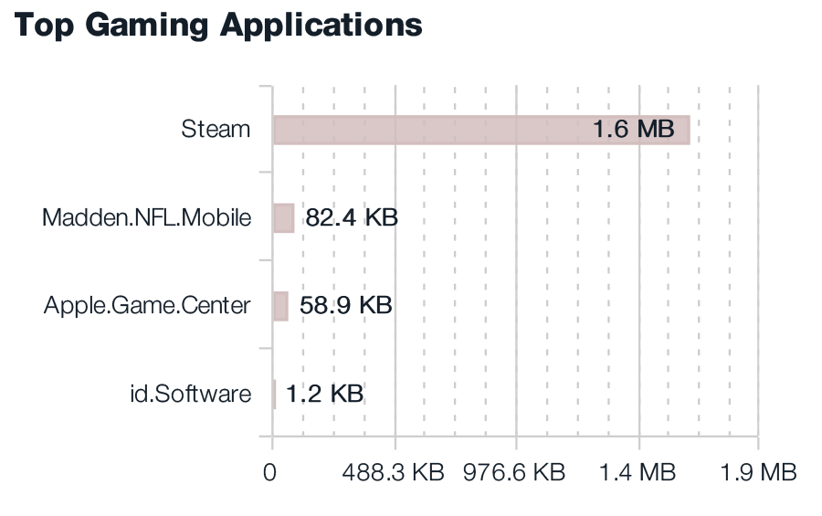
Productivity
Are you making the best use of your network resources?
Application categories and cloud usage
Peer to peer, proxy app and remote access
Web-based applications and browsing habits

Slide 9
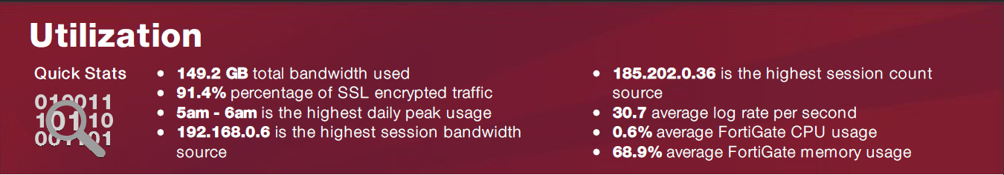
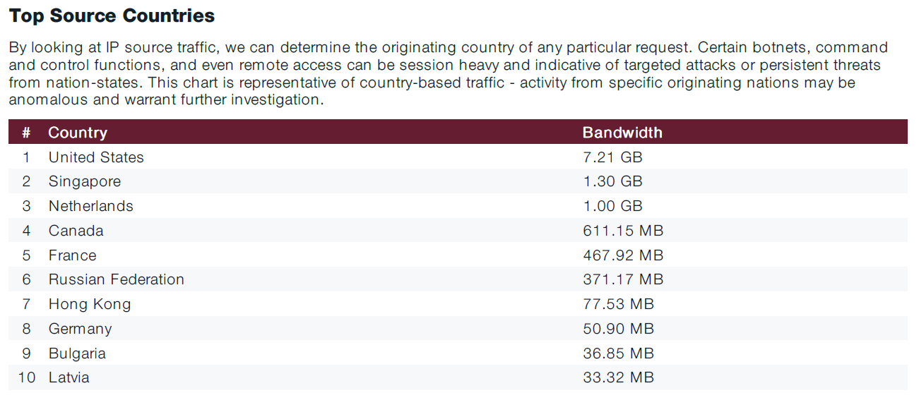
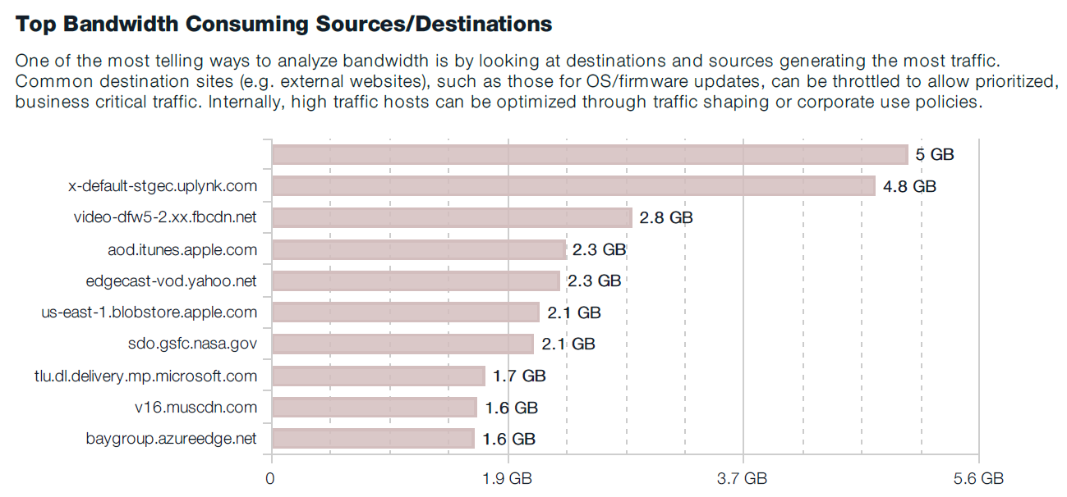
Utilization
Could your productivity be improved with some changes?
Bandwidth analysis and top consumers
Sizing information — average log rates/sessions
FortiGate CPU and memory utilization

