Slide 1
Managed IT Solutions for the Financial Industry
How TPx and [Partner] Can Help

Slide 2
Managed IT for Financial Companies
1

Slide 3
Agenda
Landscape
Challenges
How We Help
Why TPx

Slide 4
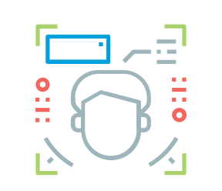
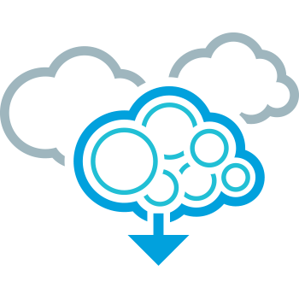

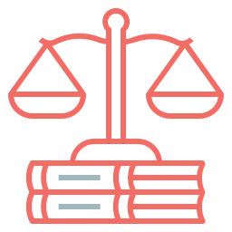
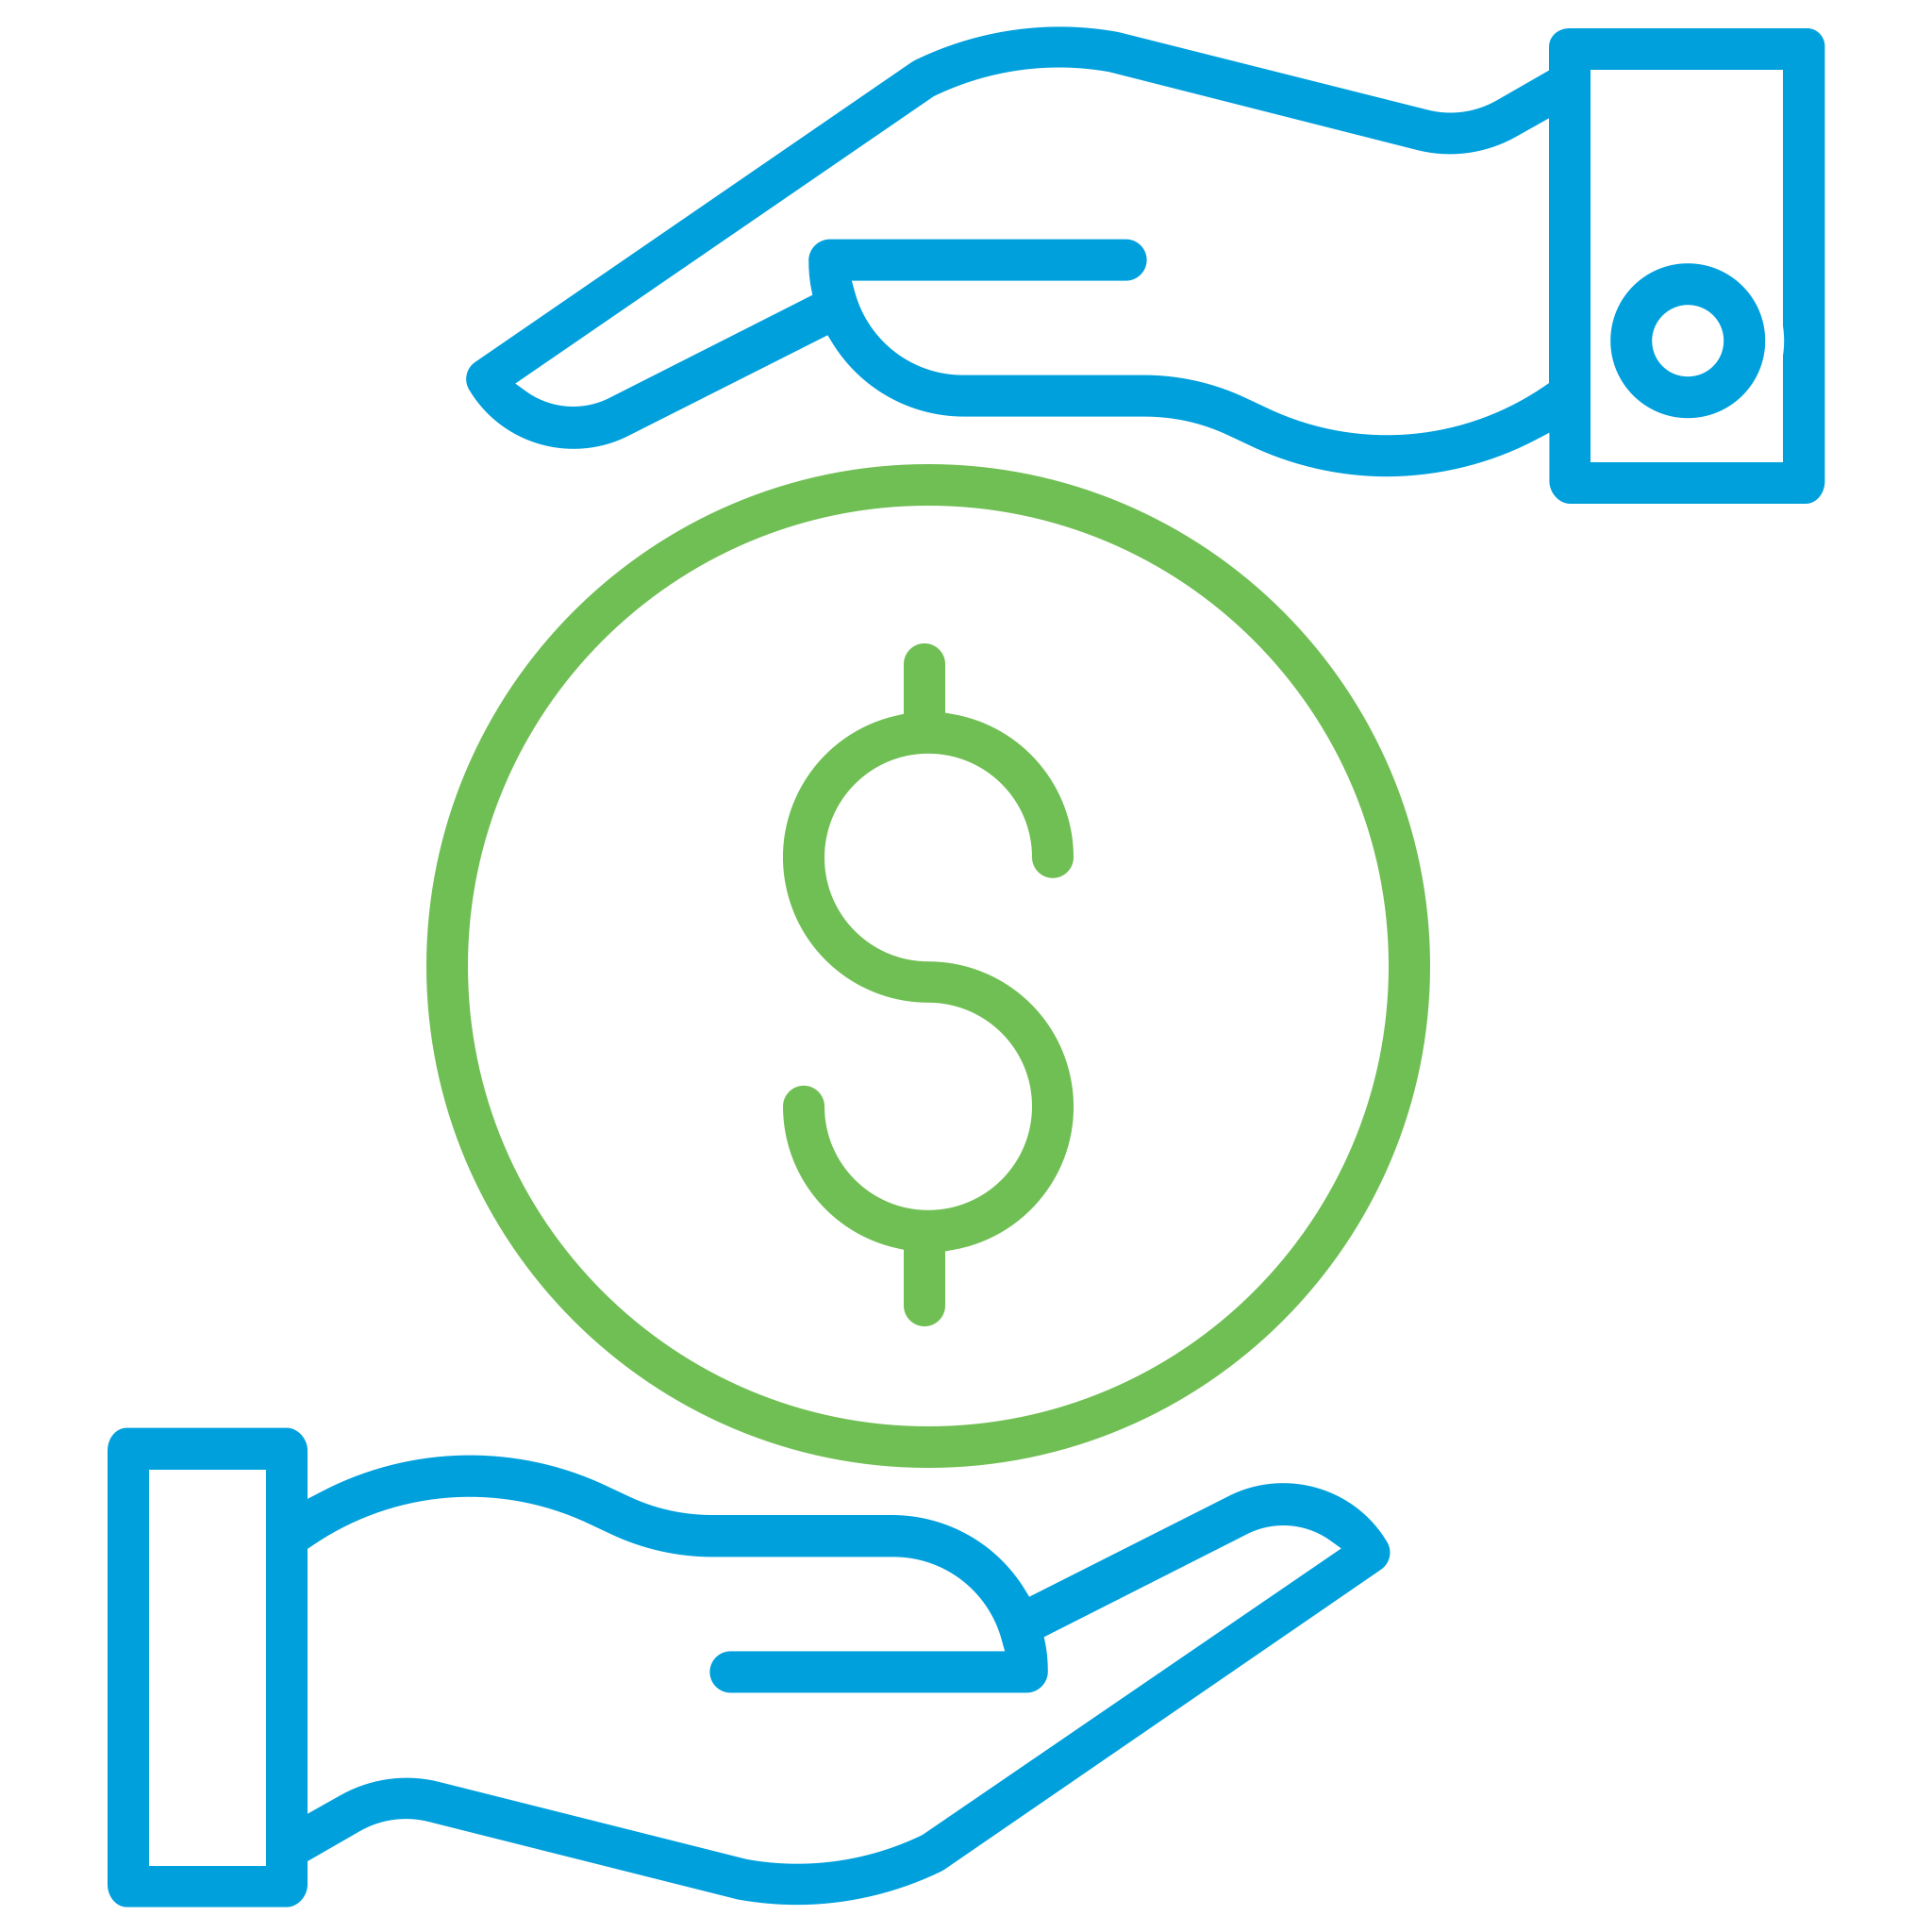

Current Landscape
Cybersecurity
front and center
Rapid cloud adoption
Digitization
of services
Growing number
of regulations
Pressure to innovate
Optimizing
costs
Notes:
Are these the case also for your organization? Would you add any?

Slide 5


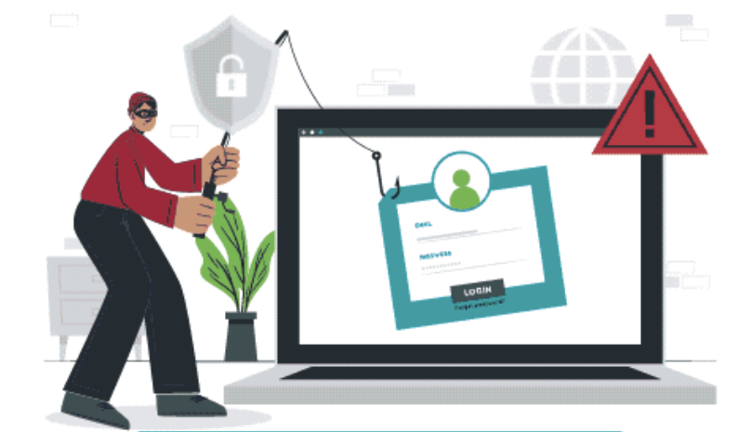
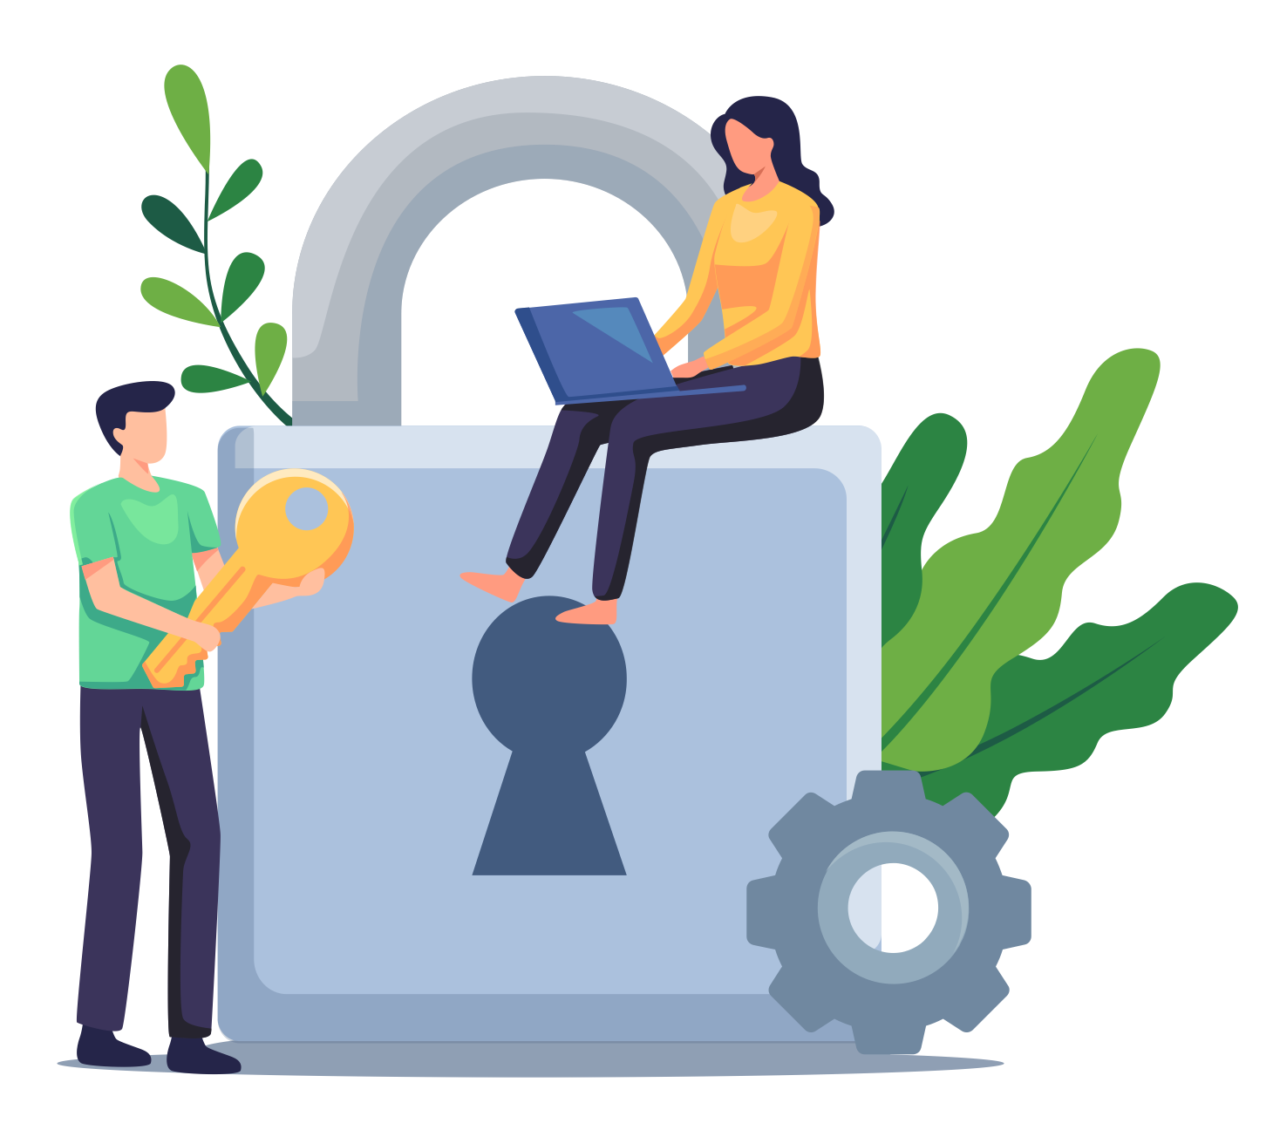

Cybersecurity Landscape
The most cyber attacks for the fourth year
in a row
(2021 IBM X-Force Threat Intelligence Index)
The second highest average cost of a data breach: $5.72M
(IBM 2021 “Cost of a Data Breach”)
Most likely target
for phishing attacks
(Cisco 2021 Cybersecurity Threat Trends)
Expected to spend 1/3+ of budgets on Managed Security and Integration by 2023
(IDC)
Cyber attacks pose the most serious threat to US financial institutions.
CEOs of four of the nation’s largest banks to Congress, May 2021
Notes:
In 2009 through 2019, American Express and SunTrust Bank were breached five times, and Capital One and Discover were breached four times each during this period. But don’t be mistaken, smaller financial institutions are a big target too, because they tend to have fewer defenses – and cyber adversaries love low-hanging fruit. Bottom line is that if you have data, you are a target. While there is no silver bullet, you have to try to keep up with the bad guys, since your reputation – and ultimately your company’s success - is on the line.

Slide 6
Key Challenges & How We Help

Slide 7
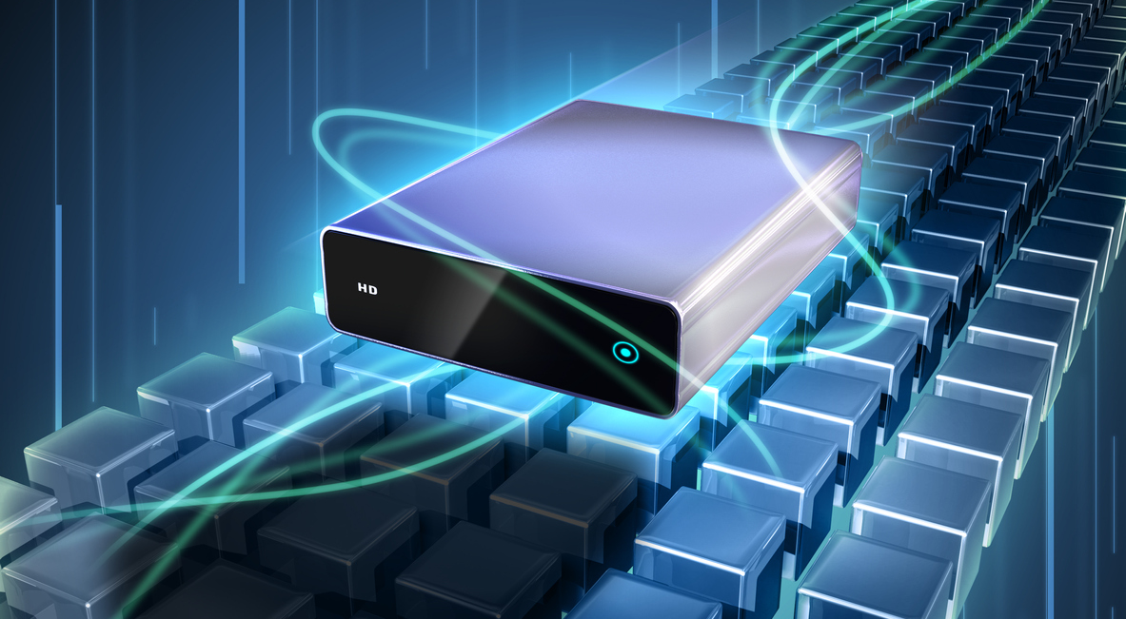
Cybersecurity Challenges
High volumes of sensitive data
Persistent cyber threats
Frequent targets of
ransomware
Rising cloud adoption
Rapid change to remote work

Slide 8

TPx Solutions
Detect and mitigate cyber threats
Augment your security team instantly with 24/7 oversight
Discover your weak points with network & cyber threat assessments
Educate your staff on proper cyber security hygiene
Keep your data and systems backed up and secure
Managed Firewalls with own SOC
Managed Endpoints
MDR
Security Awareness Training
Managed Backups
& Disaster Recovery
Security Advisory Services

Slide 9

Connectivity Challenges
Moving increasingly to the cloud adds security and connectivity concerns
Added pressure to provide
services virtually
Rise in remote and hybrid office environments
Increased Internet traffic causes issues with bandwidth capacity
Greater security and compliance responsibilities

Slide 10


TPx Solutions
Simplifying how businesses provision & manage networks across several locations
Significant cost savings
Better network visibility, security, control
Reliable Internet access, even in remote areas
Easier to scale and manage
Ability to segment business and private web traffic
24/7 monitoring and alerting
Access
Managed SD-WAN
Managed Networks Firewalls/WAN, LAN, switches
Did You Know?
Average expected savings per location by moving to ​SD-WAN is ~25% (Gartner)

Slide 11

Collaboration Challenge
Adapting to a new way of working and communicating with customers
Being able to communicate effectively to the public
Being able to provide excellent customer experience over digital tools

Slide 12
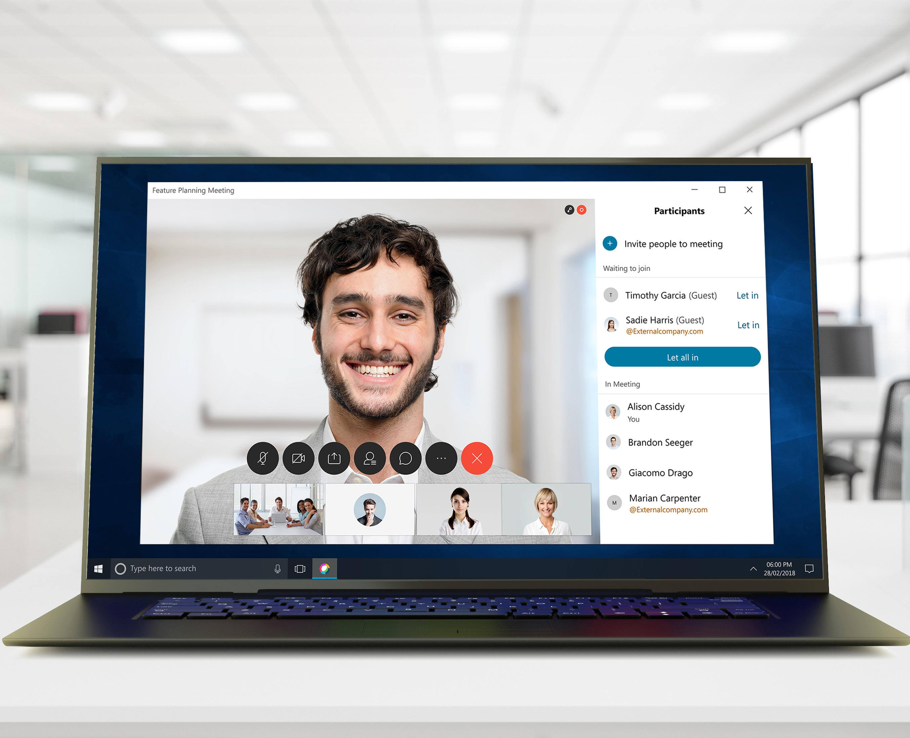
TPx Solutions
Being able to communicate and access data from anywhere, anytime
Enterprise-grade security and
end-to-end encryption
Video, phone calling, call center, messaging and meetings all delivered in a single application
Secure online file storage/sharing
Unlimited online meetings
UCx with Webex
UCx Calling for Microsoft Teams
UCx SmartVoice SIP Trunks

Slide 13


Lack of Resources Challenge
IT and cybersecurity talent is hard to find and retain
Funding is always hard to come by
Did You Know?
Cybersecurity Skills Gap Contributed to 80% of Breaches According to New Fortinet Report

Slide 14

TPx Solution
We worry about hiring, training and retaining the right talent
We can take on things that would be more expensive to do in-house
We charge a monthly flat fee, making it easy for you to stay within your budget

Slide 15


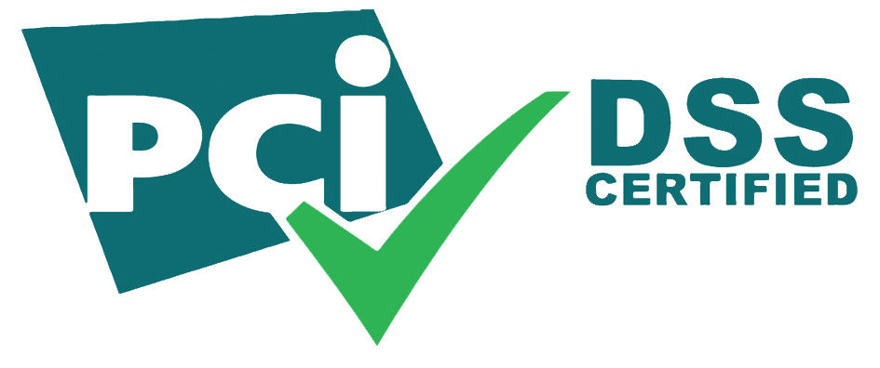




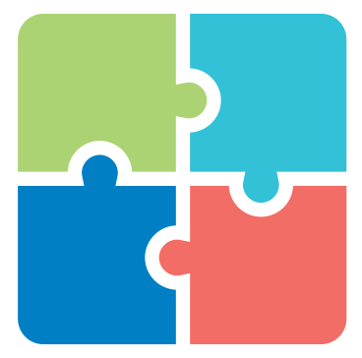
Why Choose TPx
We solve the biggest IT issues — cybersecurity, collaboration and communication —
under one umbrella
We offer PCI DSS compliant solutions
We have IT solutions, staff, and experience to do it effectively and within budget
120+ certifications
across 60+ categories —CompTIA, Silver Peak, Cisco, Fortinet, AWS, SMC…
TPx is trusted by 1200+
finance customers
We modernize your IT and communications, while minimizing your risk from cyber threats
With 18,000 clients in 49,000+ locations, TPx is big enough to get the job done and small enough to be agile
You can customize — different service levels, mix/match solutions — to best suit your needs

Slide 16

Who is TPx?
A nationwide managed
services provider (MSP)
making technology accessible
for businesses and IT teams
to drive better outcomes.
Notes:
At TPx, we make IT more accessible for businesses and IT teams to drive better outcomes and obtain peace of mind. For over 20 years, TPx has been a trusted IT provider for businesses nationwide offering a full suite of business internet, networking, cybersecurity, and cloud communications solutions.
But you might be asking just what is a managed services provider and how can an organization like TPx help? Our job is to manage your IT, so you can focus on running your business.

Slide 17

Making IT Easier For You
TPx manages your IT so you can focus on running your business. Take advantage of:
Agile solutions tailored to your unique needs
Fully managed and co-managed service options
24/7 monitoring and support
Reliable service to ensure business continuity
Highest level of security and compliance
Notes:
We know the IT landscape is complicated. And businesses not only have to keep up with changes in technology but ensure they have enough resources, staff, and time to get the job done. TPx helps alleviate that burden by acting as an extension of your team. We have the subject matter expertise to help solve real IT challenges. With TPx you can expect:
Agile solutions and services that are customizable. IT isn’t one size fits all, which is why we create a unique service offering with best-in-class technology specific to your needs.
We offer both fully managed and co-managed service level options along with 24/7 monitoring and support, so you not only gain greater flexibility but peace of mind as well.
We stand behind our services with guaranteed high service reliability and the highest level of security and compliance.

Slide 18

Delivering More Value
Buy Only What You Need
Save money by only buying what you need with the ability to scale when you need.
Get a Leading Tech Stack
TPx offers best-in-class technology that’s backed by our 24/7 customer support team.
Tap Into Certified Experts
Gain the expertise of our experienced employees that hold over 120 different IT certifications.
Notes:
At TPx, we deliver on value. One of the biggest advantages of working with TPx is the cost savings you’ll realize by not managing your IT in-house. With on-site and legacy technology, you typically have Capital expenditures where the return on your investment will take much longer to realize.
With our services model, buy only what you need, when you need it. There is a significant advantage to opting for an Opex model. You won’t have to worry about costly technology upgrades or keeping up with IT certifications and training. Realize ROI faster through an operational expenditure and gain greater flexibility and scalability for future growth.
Beyond the cost advantages of working with TPx, you get access to the latest technology. TPx partners with leading technology providers who are recognized by Gartner, Forrester, IDC, and others. We work with the best in the industry to curate an unmatched IT services experience backed by our 24/7 customer support team.
With certified experts on staff, you won’t have to worry about making sure you have a specific IT skill-set in-house. Tap into our experience. Not only do our employees hold over 120 different IT certifications, but we have the experience of managing IT for over 18,000 businesses. That is experience at scale.

Slide 19




One Provider. Multiple Solutions.
Business Internet
Networking
Cybersecurity
Cloud Communications
Seamlessly connect with customers and suppliers
Increase productivity and remove complexity from your network
Stay connected with unified communications
Secure your business with cybersecurity services
Notes:
By using a single provider like TPx for multiple services, you can optimize your IT spend and improve connectivity across your environment.
One service effects another so if you buy an app from one provider, get your internet from another, and your security from yet another provider – the visibility across your environment is muddy and unclear. When issues arise - it can be difficult to get them resolved quickly.
A single provider for multiple services creates a more holistic view of your IT environment and can improve operations.
TPx has an expansive portfolio that falls under four main categories: business internet, networking, cybersecurity and cloud communications.
Our best of breed solutions can stand on their own, but our customers see greater value when they are combined.

Slide 20
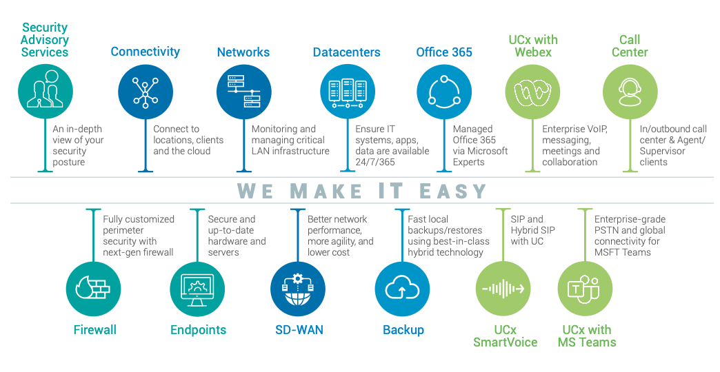
Managed IT Services
Notes:
Because when deployed together, they create a complete end-to-end IT infrastructure.
Our full services offering allows us to connect & protect businesses across the country. With cloud communications, business internet and networking solutions that connect teams and drive productivity to cybersecurity solutions that address evolving threats.
We can manage or co-manage these services to best fit your needs. But when you partner with TPx – you get more than just a solution. You gain decades of experience, subject matter expertise, and IT that is accessible at scale.
We are committed to providing IT that every company deserves and the peace of mind every business needs.

Slide 21
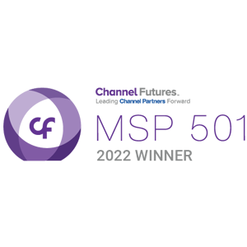

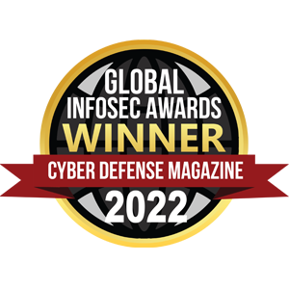


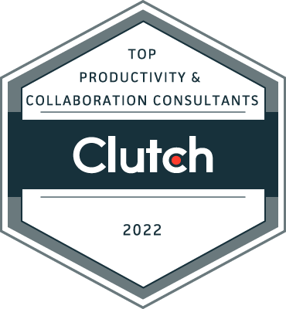
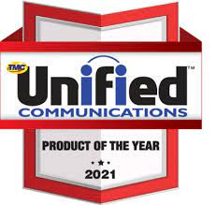


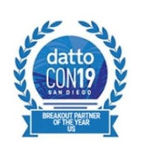
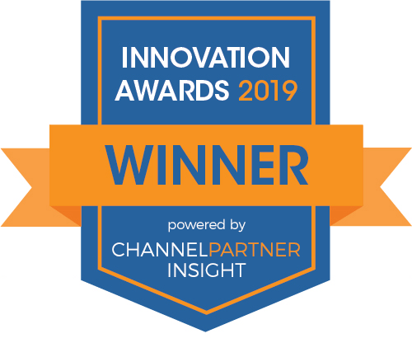
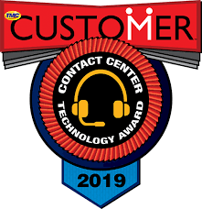
Award-Winning
Services & Solutions
Notes:
Recognized in the industry for quality service and solutions, you can rest assured your IT is in good hands with TPx.

Slide 22
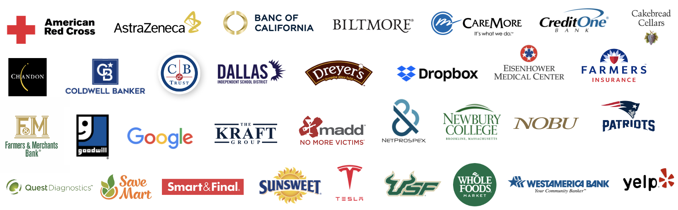



Experienced. Reliable. Proven.
TPx powers communications, business internet, networking and
cybersecurity for more than 18,000 businesses in the US.
Notes:
Don’t just take our word for it – TPx is trusted by over 18,000 businesses from national and regional brands to small businesses nationwide.

Slide 23
Proposal Overview
2
Notes:
So that’s a high-level overview of who TPx is, the services we offer, and how we can help, but now let’s dive into <Service Name>

Slide 24
Pricing Overview
Notes:
Share your screen to show proposal deck

Slide 25









TPx at a Glance
WHO WE ARE
IT SERVICES WE PROVIDE
Business Internet
Networking
Cybersecurity
Cloud Communications
Founded in
1998
TRUSTED
EXPERIENCED
20+
Years in Business
5
SSAE 18
Datacenters
Nationwide
Headquartered in
Austin, TX
~1K
Manage IT Services for
State-of-the-Art
Security
Operation Centers
Nationwide
Coverage for
49K
locations
Employees located from coast to coast
18K
550+
Customers
Nationwide
HIPAA/PCI compliant
CEO
Rick Mace
Technical Engineers

